Slide 1
IBM University Engagement Project Submission
“Exploring the Power of Agentic AI with IBM Granite and LangFlow”

Slide 2

Project Title – 🎓 AI-Powered College Admission Agent using IBM Granite and Langflow
Domain of Project – Artificial Intelligence & Education Technology (EdTech)
Student Name | Recent Passport Photo | Email ID | Mobile number [WhatsApp]
Dhanish Ladwani |  | dhanishladwani@gmail.com | 8014110111

Slide 3
Problem Statement -
🎯 Problem Statement
AI-Powered College Admission Agent using RAG and IBM Granite
Educational institutions receive thousands of admission-related queries from students regarding eligibility criteria, fee structures, scholarships, hostel facilities, placements, admission deadlines, and application procedures. Traditional admission support systems often rely on manual responses, static websites, or helplines, which can lead to delayed communication, inconsistent information, and increased administrative workload.
To solve this problem, the proposed project develops an AI-Powered College Admission Agent using Retrieval-Augmented Generation (RAG), IBM Granite, and Langflow. The system retrieves relevant information from institutional documents and official admission resources, then generates accurate and context-aware responses to student queries in real time.
The chatbot allows prospective students to interact using natural language and instantly receive reliable guidance related to admissions, courses, fees, eligibility, scholarships, and campus facilities. By combining document retrieval with generative AI, the system improves transparency, accessibility, efficiency, and overall student experience while reducing the burden on admission departments.
The project is implemented using IBM Cloud Lite services, IBM watsonx.ai, IBM Granite foundation models, Langflow, Flask, HTML, CSS, and JavaScript to create an intelligent and user-friendly admission support platform.

Slide 4
Technology Used
💻 Technologies Used
🔹 Frontend
HTML5
CSS3
JavaScript
🔹 Backend
Python
Flask Framework
🔹 AI & RAG Technologies
IBM watsonx.ai
IBM Granite Models
Retrieval-Augmented Generation (RAG)
Langflow
🔹 Cloud Platform
IBM Cloud Lite

Slide 5
Proposed Solution -
💡 Proposed Solution
LangFlow + IBM watsonx.ai + Granite Models
The proposed system is an AI-powered College Admission Agent developed using Retrieval-Augmented Generation (RAG) technology to provide accurate and real-time admission assistance to students. The solution integrates IBM Granite foundation models through IBM watsonx.ai with Langflow-based orchestration to create an intelligent conversational chatbot.
The system retrieves information from uploaded institutional documents such as admission brochures, fee structures, scholarship details, placement records, and hostel policies. Using RAG architecture, the chatbot combines document retrieval with generative AI capabilities to generate context-aware and reliable responses to user queries.
The proposed solution includes:
AI-powered admission chatbot
Real-time question answering system
Document-based information retrieval
Eligibility checking module
Fee structure and deadline assistance
Scholarship and placement guidance
Interactive and responsive web interface
The frontend is developed using HTML, CSS, and JavaScript, while Flask is used as the backend server for handling API communication between the user interface and Langflow pipeline. IBM Granite models process user queries and generate intelligent responses based on institutional knowledge data.
This solution improves accessibility, reduces manual admission inquiries, enhances response accuracy, and provides a seamless admission support experience for prospective students.

Slide 6
Langflow component Used -
1) Chat Input
Interface where users enter admission-related queries such as fees, eligibility, scholarships, hostel facilities, placements, and deadlines.
2) IBM watsonx.ai Agent
Processes user queries using IBM Granite foundation models to generate intelligent, accurate, and context-aware responses.
3) IBM Granite Model
Granite-3.3-8B-Instruct — Used for natural language understanding and real-time AI-generated admission assistance.
4) Chat Output
Displays AI-generated responses including admission guidance, eligibility information, fee details, scholarship support, and other student-related assistance.
5) Read File Component
Loads and retrieves institutional PDF documents such as admission brochures, fee structures, hostel policies, and scholarship details for knowledge retrieval.
6) Prompt Template
Formats user queries and document context into structured prompts before sending them to the IBM Granite model for response generation.
7) Langflow Pipeline
Manages the complete RAG workflow by connecting document retrieval, prompt handling, IBM Granite processing, and chatbot response generation.

Slide 7
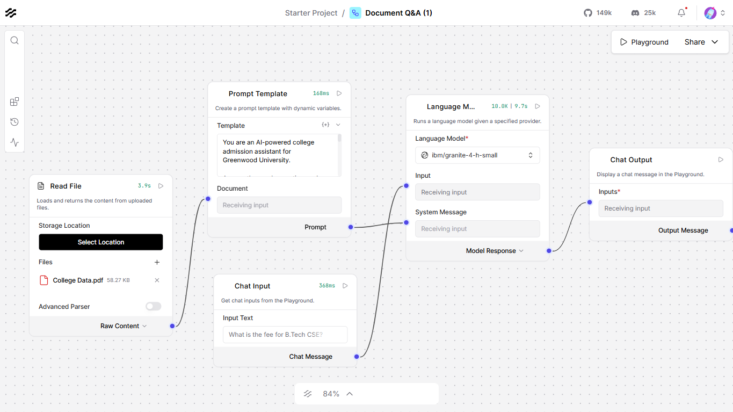
Langflow workflow -

Slide 8
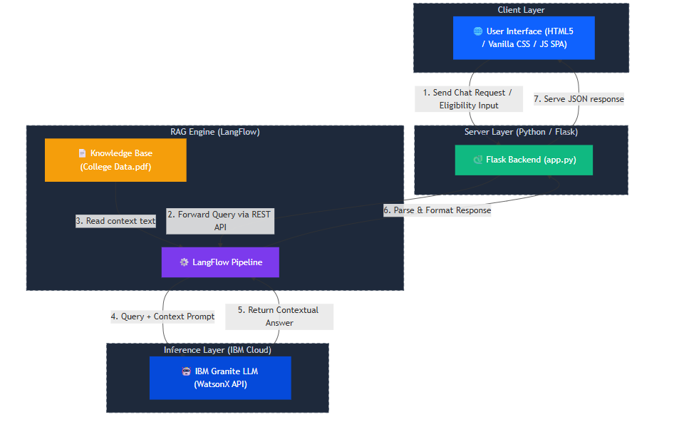
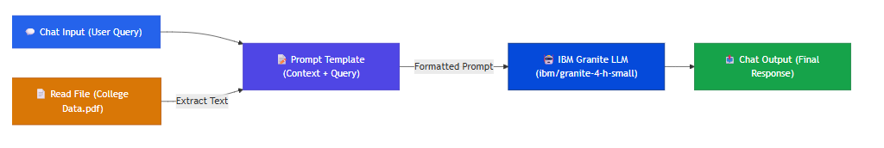
Architecture blueprint

Slide 9

Role of Agentic AI in the solution
Role of Agentic AI in College Admission Agent
Agentic AI enables the College Admission Agent to function as an intelligent, interactive, and autonomous admission support system rather than a simple rule-based chatbot. Using IBM watsonx.ai and IBM Granite models, the system can understand student queries, retrieve relevant information from institutional documents, and generate accurate, context-aware responses in real time.
The agent uses a Retrieval-Augmented Generation (RAG) approach to analyze admission brochures, fee structures, scholarship policies, hostel rules, placement details, and eligibility criteria. Instead of providing fixed responses, the AI dynamically retrieves relevant information and generates personalized answers based on the student’s query.
The system performs multiple intelligent tasks such as:
Understanding natural language admission queries
Retrieving relevant information from uploaded documents
Generating accurate and student-friendly responses
Providing eligibility and fee-related guidance
Assisting with scholarships, placements, and deadlines
Maintaining conversational interaction for better user experience
Agentic AI also improves decision-making by providing reliable and real-time information to prospective students. The system reduces manual workload for admission departments while enhancing accessibility, transparency, and efficiency in the admission process.
Overall, Agentic AI transforms the solution into a smart digital admission assistant capable of delivering fast, accurate, and intelligent admission support for educational institutions.

Slide 10
Technology Used
Langflow platform – For designing and orchestrating the RAG-based admission assistant workflow visually.
IBM Granite model – ibm/granite-3.3-8b-instruct – Used for natural language understanding, reasoning, and intelligent response generation for admission-related queries.
IBM Cloud Lite – Provides the infrastructure and environment to build, run, and integrate the AI-powered admission assistant efficiently.
RAG (Retrieval-Augmented Generation) – Retrieves relevant information from institutional documents first and then generates accurate, context-aware responses for students.
IBM watsonx.ai – Used for accessing IBM Granite foundation models, AI inference, and model integration.
PDF Knowledge Base – Stores admission brochures, fee structures, scholarship details, hostel rules, and placement-related information for retrieval.
Flask Framework – Acts as the backend server for handling API communication between the frontend and Langflow pipeline.
HTML, CSS, and JavaScript – Used for developing the responsive and interactive frontend interface of the admission assistant.
REST API Integration – Enables communication between the frontend, Langflow workflow, and IBM Granite AI services.

Slide 11
Novelty and Uniqueness
The proposed College Admission Agent stands out by combining Agentic AI, Retrieval-Augmented Generation (RAG), IBM Granite Models, and real-time document-based assistance into a single intelligent admission support system.
AI-Powered Admission Assistance
Instead of a traditional rule-based chatbot, the system uses IBM Granite models to understand natural language queries and generate intelligent, context-aware responses for students.
RAG-Based Accurate Responses
The solution retrieves real-time information from institutional documents such as admission brochures, fee structures, scholarship policies, and hostel guidelines before generating answers, reducing misinformation and improving reliability.
Smart Document Understanding
The system can analyze and summarize data from multiple uploaded PDF documents, allowing students to receive quick and accurate admission-related guidance instantly.
Interactive and Personalized Support
Students can ask personalized queries regarding courses, eligibility, fees, scholarships, placements, and deadlines, and receive student-friendly responses in real time.
Modern and Responsive User Interface
The project includes a premium AI-powered web interface with interactive chat support, eligibility checking, fee visualization, and admission deadline tracking for enhanced user experience.
IBM Granite + Langflow Integration
The solution integrates IBM watsonx.ai, IBM Granite foundation models, and Langflow orchestration to create a scalable and intelligent AI-driven admission platform.
Reduced Administrative Workload
The system automates repetitive admission inquiries, helping institutions improve operational efficiency while providing 24/7 support to prospective students.
This makes the solution a smart, scalable, and intelligent digital admission assistant, rather than just a basic informational chatbot.

Slide 12
Git Hub Link
https://github.com/dhanish0711/College-Admission-Agent
·
·
·

Slide 13
Future Scope
1. AI-Powered Voice Assistant & Multilingual Support –
The system can be enhanced with voice-enabled interaction and multilingual support so that students can communicate naturally in their preferred language. This will improve accessibility and provide a better user experience for students from diverse linguistic backgrounds.
2. Integration with College ERP Systems –
The admission agent can be integrated with institutional ERP and student management systems to provide real-time admission status, application tracking, fee payment updates, and personalized student information.
3. Advanced RAG and Vector Database Integration –
Future versions can include advanced vector databases such as FAISS or ChromaDB for more efficient document retrieval, faster responses, and improved contextual accuracy.
4. Personalized Course Recommendation System –
The system can analyze student interests, academic performance, and career goals to recommend suitable courses, specializations, and career paths.
5. Mobile Application Deployment –
The admission assistant can be expanded into a dedicated Android/iOS mobile application to provide students with seamless access anytime and anywhere.
6. Real-Time Notification & Reminder System –
The platform can send automated notifications regarding admission deadlines, exam dates, counseling rounds, fee payments, and scholarship announcements.
7. Integration with Voice and Video Support –
Future improvements may include AI-powered video counseling and voice interaction features for a more interactive and human-like admission guidance experience.
8. Scalable Enterprise-Level Deployment –
The system can be deployed at a larger scale across multiple colleges and universities using IBM Cloud infrastructure for centralized AI-based admission support.
·
·
·

Slide 14


